Slide 1
Dimensionality Reduction & Clustering Reactions
Meeting 1 – May 12, 2023

Slide 2
Classification of Metabolic Reactions
Data Preprocessing:
Select subset of equidistant time points
Remove reactions with constant values over time
Eliminate transport and exchange reactions
Remove redundant reactions, keep one representative for coupled reactions
Clustering:
Group metabolic reactions based on flux values over time and samples
Use unsupervised machine learning techniques, such as clustering algorithms
Determine optimal number of clusters using predefined criteria
Random Forest Classifier:
Use flux-states resulting from clustering as labels
Train a Random Forest classifier to predict flux-state labels based on reactions
Ensemble learning method with multiple decision trees
Feature Importance:
Compute feature importance using Mean Decrease in Accuracy (MDA) metric
Measure importance of reactions in accurately predicting flux-states
Identify reactions with significant impact on differentiating flux-states

Slide 3
Alternative Methods
Alternative Methods to Consider:
Other techniques may be preferred over clustering and random forests in certain situations
Here are some reasons why alternative methods might be beneficial:
Interpretability:
Clustering alone may not reveal specific important reactions.
Random forests' interpretation is limited to the classifier's context.
Other methods (e.g., feature selection, interpretability-focused dimensionality reduction) provide clearer insights into specific reactions and their relevance.
Dimensionality Reduction:
High-dimensional datasets (e.g., hundreds or thousands of reactions) can benefit from dimensionality reduction.
Techniques like PCA, NMF, or Sparse PCA capture essential information while maintaining interpretability.
Reducing dimensionality addresses the curse of dimensionality, improves computational efficiency, and focuses on informative features.

Slide 4
Alternative Methods
3. Alternative ML Algorithms:
Explore other ML algorithms beyond random forests, such as SVM, gradient boosting, or deep learning.
Different algorithms have varying strengths and may yield better results for identifying relevant reactions.
4. Combination of Techniques:
Combining approaches can provide a comprehensive analysis.
Use clustering to identify initial patterns, then apply dimensionality reduction or feature selection within each cluster.
This hybrid approach leverages the strengths of different methods for a more comprehensive analysis.

Slide 5
Next Steps: Preserving interpretability while using PCA
Feature Selection:
Use tailored feature selection techniques (e.g., mutual information, L1 regularization, recursive feature elimination) to identify informative reactions for analysis (reduce noise, eliminate redundant or irrelevant features).
Retain interpretability of original metabolic reactions without relying on latent space representation.
Interpretability-Aware Dimensionality Reduction:
Explore techniques like NMF or Sparse PCA for dimensionality reduction while preserving interpretability.
Obtain reduced-dimensional representations that can be interpreted in terms of original metabolic reactions.
Integration of PCA with Feature Importance:
Apply feature selection techniques to the original set of reactions to identify informative features.
Perform dimensionality reduction using NMF or Sparse PCA on the selected features.
The reduced-dimensional representation will contain a subset of important reactions that are interpretable and relevant for analysis.
Analyze the reduced-dimensional data to gain insights into the relationships and dynamics of metabolic reactions.

Slide 6
Dimensionality Reduction & Clustering Reactions
Meeting 2 – May 22, 2023 (Cancelled)

Slide 7
Data Pre-Processing & Feature Selection
Preprocessing:
Select subset of equidistant time points: To select a subset of time points, you can define a fixed interval and choose representative time points within that interval. For example, you can select every nth time point or evenly spaced time points.
Remove reactions with constant values over time: Identify reactions that have the same value across all time points and remove them from the dataset. These reactions do not contribute to the variability and can be considered constant.
Eliminate transport and exchange reactions: Transport and exchange reactions often have consistent and uninformative patterns across different samples. Removing them can help focus on reactions with more meaningful variations. You can identify these reactions based on specific identifiers or patterns in their names or annotations.
Remove redundant reactions, keep one representative for coupled reactions: If you have reactions that are highly correlated or coupled, you can remove redundant reactions and keep one representative. This can reduce the redundancy in your data and improve computational efficiency.

Slide 8
Data Pre-Processing & Feature Selection
Feature Selection: When working with sparse matrices, traditional feature selection methods like filter methods (e.g., mutual information, correlation) may still be applicable. However, they might not fully leverage the sparsity of the data. Consider the following options:
Sparse feature selection methods: Look for feature selection techniques specifically designed for sparse data, such as L1 regularization (Lasso) or sparse linear regression. These methods encourage sparsity in the selected features and can effectively handle sparse matrices.
Univariate feature selection: Use univariate statistical tests (e.g., chi-square test, ANOVA) to evaluate the relationship between each feature and the target variable. Select features with significant p-values or high scores as they are more likely to be informative.
Feature selection with dimensionality reduction techniques: Instead of performing feature selection separately, you can combine it with dimensionality reduction methods like PCA. Some variants of PCA, such as sparse PCA or regularized PCA, can directly incorporate feature selection into the dimensionality reduction process.

Slide 9
PCA
Dimensionality Reduction (PCA): PCA can still be a good option for dimensionality reduction, even with sparse matrices. However, traditional PCA may not fully exploit the sparsity of the data. Consider the following suggestions:
Sparse PCA: Look for sparse PCA implementations that are specifically designed for sparse data. Sparse PCA methods consider the sparsity of the data and aim to find sparse representations of the original features.
Randomized PCA: Randomized PCA is an approximation algorithm that can speed up the computation of PCA for large sparse datasets. It provides a close approximation to the principal components while reducing computational complexity.
Incremental PCA: Incremental PCA is useful when memory is a constraint. It processes the data in batches, allowing you to perform PCA on large sparse datasets without loading the entire dataset into memory.

Slide 10
Process
Overall Process: Here's a suggested workflow that incorporates preprocessing, feature selection, and PCA:
Preprocess the data: Select subset of equidistant time points, remove reactions with constant values, eliminate transport and exchange reactions, and remove redundant reactions.
Perform feature selection: Apply appropriate feature selection methods, considering the sparsity of the data. Use sparse feature selection techniques or combine feature selection with dimensionality reduction methods like PCA.
Apply dimensionality reduction (PCA): Use PCA or its variants, such as sparse PCA or randomized PCA, to reduce the dimensionality of the selected features. Consider memory-efficient algorithms like incremental PCA if memory is a concern.
Analyze the results: Evaluate the loadings and contributions of the features in the reduced-dimensional space. Rank and interpret the important reactions based on their weights or loadings.

Slide 11
Speeding up process
When working with large and sparse matrices, the preprocessing, feature selection, and PCA steps can be computationally intensive. Here are some suggestions to speed up the process:
Parallelization: Utilize parallel computing techniques to distribute the computations across multiple cores or machines. This can significantly reduce the processing time, especially when dealing with large datasets. Libraries like joblib or dask provide convenient tools for parallelization.
Sparse matrix operations: Take advantage of sparse matrix operations and algorithms specifically designed for sparse data. Sparse matrix representations and optimized algorithms can speed up computations and reduce memory requirements. Make sure to use libraries that support sparse matrix operations, such as scipy.sparse or scikit-learn for PCA with sparse data.

Slide 12
Speeding up process
Dimensionality reduction with truncated SVD: Instead of using traditional PCA, consider using truncated SVD (Singular Value Decomposition) for dimensionality reduction. Truncated SVD is particularly efficient for sparse matrices and can provide similar results to PCA. Libraries like scikit-learn provide implementations of truncated SVD.
Remember to evaluate the trade-off between computation time and the level of approximation or accuracy required for your specific analysis. Adjust the parameters and techniques accordingly to balance speed and quality of results.
By incorporating these strategies, you can speed up the preprocessing, feature selection, and PCA steps for large and sparse matrices, making the analysis more efficient and manageable.

Slide 13
Dimensionality Reduction on dFBA
Meeting 3 – June 6, 2023

Slide 14
PCA
Time series data has temporal dependencies, which violate the independence assumption of PCA.
PCA does not account for the sequential nature of time series data, leading to inaccurate representation of dynamics.
PCA may not capture relevant temporal patterns and interactions between reactions.
Dimensionality reduction with PCA can result in loss of important information related to temporal dynamics.
Explore alternative techniques designed for time series analysis or feature selection approaches to better preserve temporal dynamics and capture important features.

Slide 15
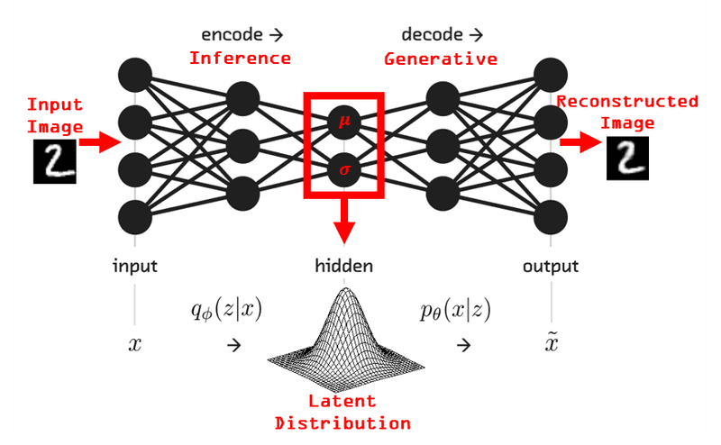
Autoencoders
Autoencoders: Neural network models for unsupervised learning and dimensionality reduction.
Purpose: Learn efficient data representations by compressing input into a latent space and reconstructing it.
Architecture: Encoder compresses input, decoder reconstructs it from the latent representation.
Training: Minimize reconstruction error between original and reconstructed data.
Key Idea: Autoencoders capture salient features, extracting meaningful representations.
Applications: Dimensionality reduction, anomaly detection, data denoising, and synthetic data generation.

Slide 16
Autoencoder Benefits
Dimensionality Reduction:
reduce data dimensionality while preserving important features
Unsupervised Learning:
learn data structure without labeled data
Anomaly Detection:
identify anomalies by comparing reconstructed data to originals
Feature Extraction:
learn informative feature representations for downstream tasks
Data Generation:
generate new data samples from the learned latent space

Slide 17
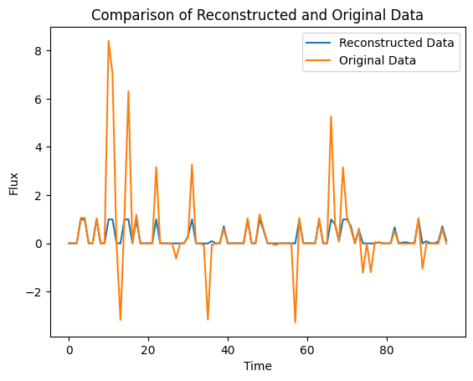
Results (working)

Slide 18
Improving Autoencoder Reconstruction
Increase model complexity:
Add more layers or neurons
Adjust activation functions
Train for more epochs:
Increase the number of training iterations
Adjust hyperparameters:
Experiment with learning rate, batch size, optimizer
Normalize or preprocess the data:
Apply scaling or normalization techniques
Try different architectures:
Explore recurrent autoencoders

Slide 19
Next
Run autoencoder on subset of data, optimize model architecture
How to use HPC

Slide 20
Dimensionality Reduction on dFBA
Meeting 3 – June 19, 2023

Slide 21
Dimensionality Reduction on dFBA
Meeting 4 – July 10, 2023

Slide 22
Update
Filtering reactions:
Select subset of equidistant time points
Remove reactions with constant values over time
Eliminate transport and exchange reactions
Remove redundant reactions, keep one representative for coupled reactions
Check if PCA can be run at each time step
Use test train and validation dataset for autoencoder data
Check meaningfulness of latent space by using reg or knn
Use loss, integration between curves over all fluxes and use this perhaps for hyperparameter (need metric for loss)

Slide 23
Update
Updated with 3D matrix (3754 x 15 x 95) with 15 cell lifelines (ran on personal computer)
Working
Add layers but memory problems
Increasing training epochs and trials
Adjust hyperparameter search space
Run for more lifelines
Latent space representation
Time steps can skip
LSTM
Goal – reduce number of reaction fluxes
Improve this latent space
Try biomass reaction

Slide 24
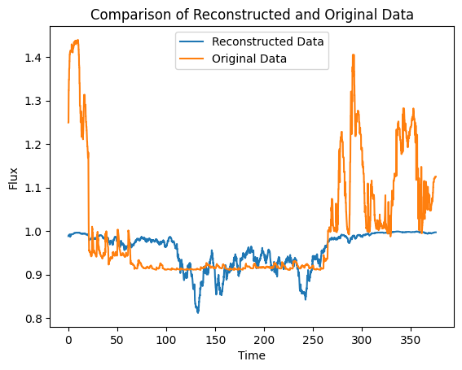
Example Results
Best Hyperparameters: {'hidden_units': 17, 'latent_units': 34, 'activation': 'relu', 'learning_rate': 0.000506829711966478} Best Loss: 1.9310521729525925

Slide 25
Project Overview
Meeting 5 – September

Slide 26
Project Scope
Project Focus
Study cell behavior in a high substrate variability industrial bioreactor
Analyze internal cell data: substrate concentration, uptake rate, metabolic analysis, and fluxes
Objectives Objective 1: Problems to Solve
Extract relevant information from internal cell data
Reduce dataset size if possible
Analyze single cell and group trends
Define meaningful metabolic states and reactions
Explore innovative data representation

Slide 27
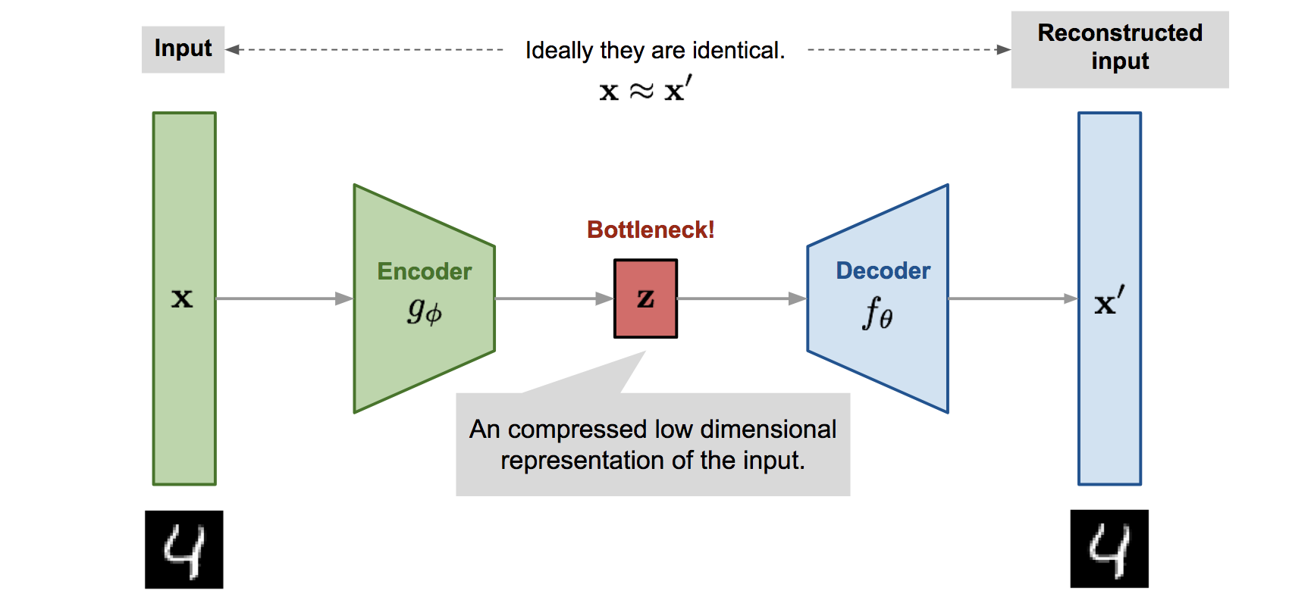
Autoencoders

Slide 28

LSTMs

Slide 29
Relevant Literature
Autoencoders Based Dimensionality Reduction
Autoencoders effectively capture complex data structures and compress information
The number of hidden layer nodes influences performance, revealing a connection to data dimensionality
Autoencoders have potential as foundational components in deep learning architectures
A Folded Neural Network Autoencoder
The folded autoencoder reduces computational complexity and surpasses PCA while matching conventional autoencoders' performance
Promising for handling high-dimensional data and enhancing dimensionality reduction
Autoencoder-based Deep Learning for Time Series Clustering
Combining K-means with autoencoders in a two-stage approach achieves high accuracy in time series data clustering
Deep learning models uncover hidden features, leading to improved clustering performance

Slide 30
Relevant Literature
Autoencoders Based Dimensionality Reduction
Autoencoders effectively capture complex data structures and compress information
The number of hidden layer nodes influences performance, revealing a connection to data dimensionality
Autoencoders have potential as foundational components in deep learning architectures
A Folded Neural Network Autoencoder
The folded autoencoder reduces computational complexity and surpasses PCA while matching conventional autoencoders' performance
Promising for handling high-dimensional data and enhancing dimensionality reduction
Autoencoder-based Deep Learning for Time Series Clustering
Combining K-means with autoencoders in a two-stage approach achieves high accuracy in time series data clustering
Deep learning models uncover hidden features, leading to improved clustering performance

Slide 31
Methodology
Transforming Lifelines to Internal Cell Data
Process: Transforming 150,000 lifelines into internal cell data
Data Elements: Time series substrate concentration, substrate uptake rate (qS), dFBA, internal fluxes
Objective 1 - Data Analysis with Autoencoders
Autoencoders: Neural networks for unsupervised learning and dimensionality reduction
Architecture: Encoder compresses data into a latent space, decoder reconstructs it
Purpose: Extract meaningful features and patterns from internal cell data
Application: Analyzing, visualizing, and reducing complexity of the data

Slide 32
Methodology
Exploring Data Reduction and Innovative Representation
Autoencoders for Dataset Reduction: Use LSTM autoencoders to reduce data complexity
Tackling Dimensionality: Address limitations of traditional methods like PCA
Identifying Relevant Features: Extracting informative insights while preserving temporal characteristics
Analyzing Lifeline Trends and Lifeline Groups
Analyzing Single Cell Lifeline: Using time series analysis, clustering, and classification
Identifying Similarities and Trends: Reveal patterns and cycles within reactor lifelines
Analyzing Lifeline Groups: Grouping cells with similar behaviors for deeper insights

Slide 33
Methodology
Determining Metabolic States and Reactions
Clustering Metabolic States: Employing various clustering techniques for reaction flux data
Insight Extraction: Identifying meaningful metabolic states and reactions
Optimization: Enhancing bioprocess control in industrial settings
Innovative Data Representation
Visualization with t-SNE: Mapping latent space for insight into data structure
Learning Manifolds with Autoencoders: Capturing and modeling data manifold structures
Powerful Representation: Effective encapsulation of underlying data distribution for interpretation and analysis

Slide 34
Innovative Strategies & Ideas
Folded Autoencoder Structure: Inspired by the folded autoencoder, explore the use of a folded autoencoder to optimize dimensionality reduction. The folded autoencoder reduces weights, improves performance, and lowers computational costs through symmetry
Regularized Autoencoders: Consider employing regularized autoencoders to enhance model capabilities. These autoencoders utilize distinct loss functions to emphasize sparsity, minimize representation derivatives, and handle noisy or incomplete inputs, allowing for more effective data extraction
Deep Autoencoders: Investigate the advantages of deep autoencoders with multiple hidden layers. Deep architectures, recognized for their approximation capabilities, can better capture complex mappings and constraints, providing significant benefits in compression and representation

Slide 35
Initial Results

Slide 37
Feature Selection
Dimension reduction using PCA (large-scale PCA)
Explained variance, and scree plot
Loadings and Biplot
Extracting the most informative features
Outlier detection

Slide 38
Dynamic simulations of microbial communities under perturbations: opportunities for microbiome engineering
Data Preprocessing: Before clustering the fluxes, the researchers perform preprocessing steps to filter out irrelevant reactions. They select a subset of equidistant time points from the time-series data. Reactions with constant values over time are removed. They also eliminate transport and exchange reactions, focusing on reactions within the inner metabolism. Additionally, redundant reactions are removed, keeping only one representative for coupled reactions.
Clustering: The metabolic reactions, based on their flux values over time and samples, are grouped using unsupervised machine learning techniques, specifically clustering algorithms. The paper refers to criteria from a previous study to determine the optimal number of clusters.
Random Forest Classifier: The flux-states resulting from clustering are used as labels for a Random Forest classifier. Random forests are an ensemble learning method that consists of multiple decision trees. In this case, the classifier is trained to predict the flux-state labels based on the reactions. This allows the researchers to identify which reactions contribute the most to differentiating between the flux-states.
Feature Importance: The feature importance of the reactions is computed using the Mean Decrease in Accuracy (MDA) metric. This metric measures the importance of each reaction in the random forest classifier for accurately predicting the flux-states. By analyzing the feature importance, the researchers can identify the reactions that have the most significant impact on distinguishing different flux-states.

Slide 39
Preserving interpretability while using PCA
Feature Selection: Instead of relying solely on PCA for dimensionality reduction, you can perform feature selection techniques specifically tailored for your task. These techniques aim to identify the most informative and relevant reactions for clustering and analysis. Some popular feature selection methods include mutual information, L1 regularization (Lasso), recursive feature elimination, or variance thresholding. By selecting a subset of important reactions, you can retain the interpretability of the original metabolic reactions without relying on a latent space representation.
Interpretability-Aware Dimensionality Reduction: Explore alternative dimensionality reduction techniques that prioritize interpretability while reducing the feature space. For example, methods like Non-negative Matrix Factorization (NMF) or Sparse Principal Component Analysis (Sparse PCA) can provide reduced-dimensional representations while still allowing for interpretation in terms of the original metabolic reactions.
Integration of PCA with Feature Importance: If PCA is used as a preliminary step, you can combine it with the analysis of feature importance obtained from the subsequent random forest classifier. After applying PCA, you can use the reduced-dimensional representation as input to the random forest classifier. The feature importance analysis can then be performed on the original metabolic reactions rather than the PCA-transformed features. This way, you can identify the important reactions in the context of the original representation while still benefiting from the dimensionality reduction provided by PCA.
Domain Expertise and Biologically Driven Filtering: Consider incorporating domain expertise and biological knowledge to guide the preprocessing steps. For instance, you can apply additional filtering criteria based on known biochemical pathways, functional categories of reactions, or other relevant biological constraints. By leveraging domain expertise, you can refine the filtering process and focus on reactions that are biologically meaningful for your specific analysis.

Slide 40
Alternatives
While the approach mentioned in the paper, combining clustering and random forests, can be effective for identifying relevant reactions, there are situations where alternative methods may be preferred. Here are a few reasons why you might consider using other techniques over clustering and random forests:
Interpretability: Clustering alone may not provide explicit insights into the importance or contribution of individual reactions. It can group similar flux profiles together but might not reveal the specific reactions that drive the differences between clusters. Random forests help in identifying important features, but the interpretation might be limited to the context of the classifier. Other techniques like feature selection or dimensionality reduction methods with interpretability objectives can provide clearer insights into the specific reactions and their relevance.
Dimensionality Reduction: If the dataset has a high number of features (e.g., hundreds or thousands of reactions), dimensionality reduction techniques like PCA, NMF, or Sparse PCA can be useful. These methods capture the essential information in a reduced-dimensional space while maintaining interpretability. By reducing the dimensionality, you can potentially mitigate issues related to the curse of dimensionality, improve computational efficiency, and focus on the most informative features.
Alternative Machine Learning Algorithms: While random forests are widely used and offer good performance, it's worth exploring other machine learning algorithms as well. For example, support vector machines (SVM), gradient boosting, or deep learning techniques like neural networks may be suitable for the specific task of identifying relevant reactions. Different algorithms have varying strengths, and trying multiple methods can provide a comprehensive analysis and potentially better results for your specific dataset.
Combination of Techniques: It's not necessarily an "either-or" choice between clustering and random forests versus alternative techniques. Instead, a combination of approaches can be beneficial. For example, you can use clustering to identify initial groups or patterns in the data, then apply other techniques like dimensionality reduction or feature selection within each cluster to identify important reactions. This hybrid approach can leverage the strengths of different methods and provide a more comprehensive analysis.
Ultimately, the choice of techniques depends on the specific goals, characteristics of the data, and the interpretability requirements of your analysis. Exploring various options, combining methods, and considering the context of the problem can help you choose the most suitable techniques for your particular research or application.

Slide 41
Analyzing Loadings
When the loadings in PCA are relatively close in magnitude, it suggests that multiple features (reactions in this case) contribute similarly to the corresponding principal component. In such situations, it can be challenging to distinguish the most important reactions solely based on the absolute values of the loadings.
To handle cases where the loadings are close, you can consider the following approaches:
Look for Consistency: Examine the loadings across multiple principal components. If a particular reaction consistently exhibits high loadings across multiple components, it indicates its importance in explaining the underlying variability in the dataset.
Consider Cumulative Explained Variance: Assess the cumulative explained variance ratio associated with each principal component. If a component contributes significantly to the cumulative explained variance, the reactions with relatively higher loadings in that component may be considered more important.
Analyze Patterns and Relationships: Instead of solely relying on the magnitude of loadings, examine the patterns and relationships among the loadings of different reactions. Look for groups of reactions with similar loadings, as they may collectively represent an important metabolic pathway or functional module.
Combine with Domain Knowledge: Incorporate prior domain knowledge, biological context, or existing literature to guide the interpretation of the loadings. Some reactions may have known functional significance or strong associations with the research problem, which can help prioritize their importance.
Perform Sensitivity Analysis: Explore the impact of varying the number of principal components used in the analysis. By including additional components, you may uncover subtle differences in the loadings that can help differentiate the importance of closely related reactions.
Remember that PCA is just one method for dimensionality reduction and feature analysis. If the closeness of loadings poses challenges in your analysis, you can consider alternative techniques such as sparse PCA, non-negative matrix factorization (NMF), or feature selection methods to further explore the importance of reactions in your research problem.

Slide 42
Cell Lifelines
If your cell lifelines data has thousands of time points but only 4 columns (x, y, z, and substrate concentration), it means that you have high-dimensional data with a large number of observations. In this case, using PCA with 4 components will not be suitable for dimensionality reduction because you are already using all the available columns.
PCA is primarily used to reduce the dimensionality of data by capturing the most significant variations in the dataset. If you want to reduce the number of rows (observations) while retaining the 4 columns, you can consider alternative techniques such as sampling or filtering methods.
Here are a couple of approaches you can consider:
Sampling: If the number of time points is too large and you want to reduce the dataset while preserving the overall distribution of the data, you can use random sampling techniques. Randomly select a subset of time points from the dataset that adequately represents the overall behavior. This will reduce the number of rows while retaining the original columns.
Filtering: If there are specific criteria or patterns you want to consider for selecting time points, you can apply filtering techniques. For example, you can filter out time points that fall within a certain range or meet specific conditions based on the substrate concentration or other relevant factors.
Both sampling and filtering methods can help you reduce the number of rows in your dataset while retaining the original columns of interest (x, y, z, and substrate concentration). After reducing the dataset, you can then perform PCA or other analyses as needed.
Remember to consider the implications of reducing the dataset on the representativeness and generalizability of your results. It's important to ensure that the reduced dataset still captures the essential characteristics and patterns of the original data.

Slide 43
Autoencoders
Problem: Multidimensionality in sensor data requires summarization for easy clustering.
Technique: Custom autoencoder using Keras for dimensionality reduction.
Architecture: Encoder and decoder with Dense layers.
Data: 20 individuals, 3 positional series of movements (length 170).
Training: First 10 individuals used for training.
Evaluation: Reconstruction errors computed for remaining individuals.
Interpretation: Low errors indicate confident activity detection.
Benefits: Captures temporal dynamics and interactions between reactions.
Applicability: Suitable for temporal data with time series representations of reactions.

Slide 44
Predictive Modeling: Autoencoders can be extended to include additional layers beyond the decoder. By incorporating supervised learning techniques, such as adding classification or regression layers on top of the autoencoder architecture, the learned features can be used for predictive modeling tasks. The encoder captures meaningful representations of the cell lifeline data, which can aid in predicting specific outcomes or properties of interest.

Slide 45
Autoencoders & Metabolic Networks
Autoencoders can provide valuable insights into cell lifelines and metabolic networks by learning compact and meaningful representations of the underlying data. Here are some ways in which autoencoders can help us gain information about cell lifelines and metabolic networks:
Reconstruction of Cell Lifelines: Autoencoders are trained to reconstruct their input data from compressed latent representations. By training an autoencoder on cell lifeline data, the decoder part of the autoencoder can generate reconstructed lifelines that closely resemble the original input. Comparing the reconstructed lifelines with the original ones can help identify patterns, similarities, and differences. This can provide insights into the dynamics and variations within the lifelines and help uncover underlying regulatory mechanisms.
Feature Extraction: The encoder part of an autoencoder learns to extract the most salient features from the input data. In the context of cell lifelines, this can include identifying important metabolites, proteins, or gene expressions that contribute significantly to the observed variations. By analyzing the learned latent space, we can gain insights into the most informative features and their relationships, which can aid in understanding the underlying biology and metabolic processes.
Anomaly Detection: Autoencoders can be used to detect anomalies or deviations from normal cell lifelines. By training an autoencoder on a dataset of healthy or normal lifelines, it can learn to reconstruct normal patterns. When presented with anomalous lifelines, the autoencoder will have higher reconstruction errors, indicating a deviation from the normal behavior. This can help identify aberrations in metabolic networks or cell lifelines, which may indicate disease conditions, drug responses, or other important phenomena.
Pathway Reconstruction: Autoencoders can capture the hierarchical relationships and interactions within metabolic networks. By training an autoencoder on metabolic pathway data, it can learn to reconstruct the pathways and identify the key reactions and metabolites involved. This can provide insights into the functional relationships between reactions, the flow of metabolites, and the overall structure of the metabolic network.
Discovery of Novel Enzymatic Reactions: Autoencoders can be used to predict potential enzymatic reactions and uncover novel interactions within metabolic networks. By training an autoencoder on a comprehensive set of known enzymatic reactions, it can learn the underlying patterns and relationships. The decoder part of the autoencoder can then generate predictions of new enzymatic reactions based on the learned representations. These predictions can guide experimental investigations and contribute to the expansion and refinement of existing metabolic networks.
In summary, autoencoders offer valuable tools for analyzing cell lifelines and metabolic networks by extracting meaningful features, reconstructing patterns, detecting anomalies, and facilitating the discovery of novel interactions and reactions. These insights can advance our understanding of biological systems, disease mechanisms, and potential drug targets.

Slide 46
Notes
Increase the number of hidden units in the encoder and decoder layers: This can provide more capacity for the model to capture the patterns and features in the data.
Add more layers to the encoder and decoder: Increasing the depth of the model can help it learn more complex representations.
Experiment with different activation functions: Try different activation functions such as 'relu', 'tanh', or 'sigmoid' to see which works best for your data.
Increase the number of training epochs: Training the model for more epochs can allow it to converge to a better solution. However, be cautious not to overfit the data.
Adjust the learning rate: Experiment with different learning rates to find the optimal value for your model.
Normalize the input data: Normalizing the input data can help the model learn more effectively and improve reconstruction quality.

